Slide 1
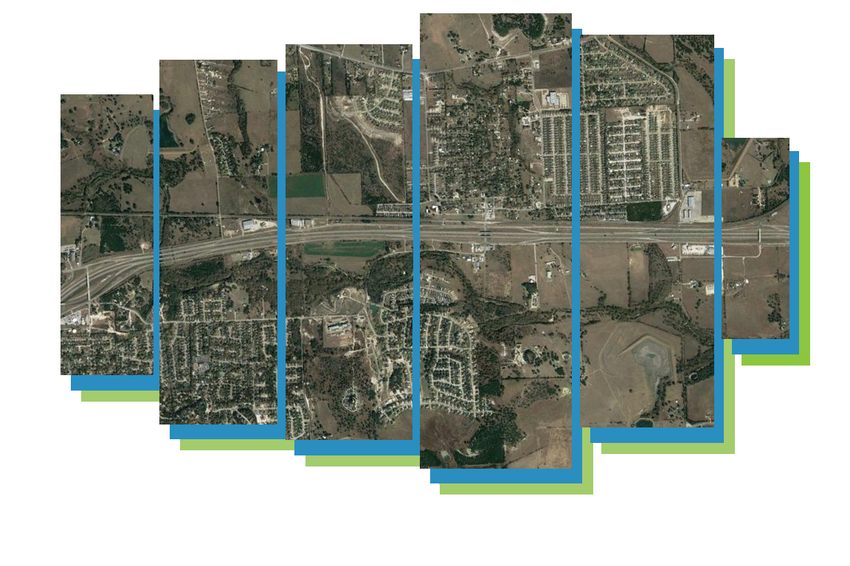



Slide 2
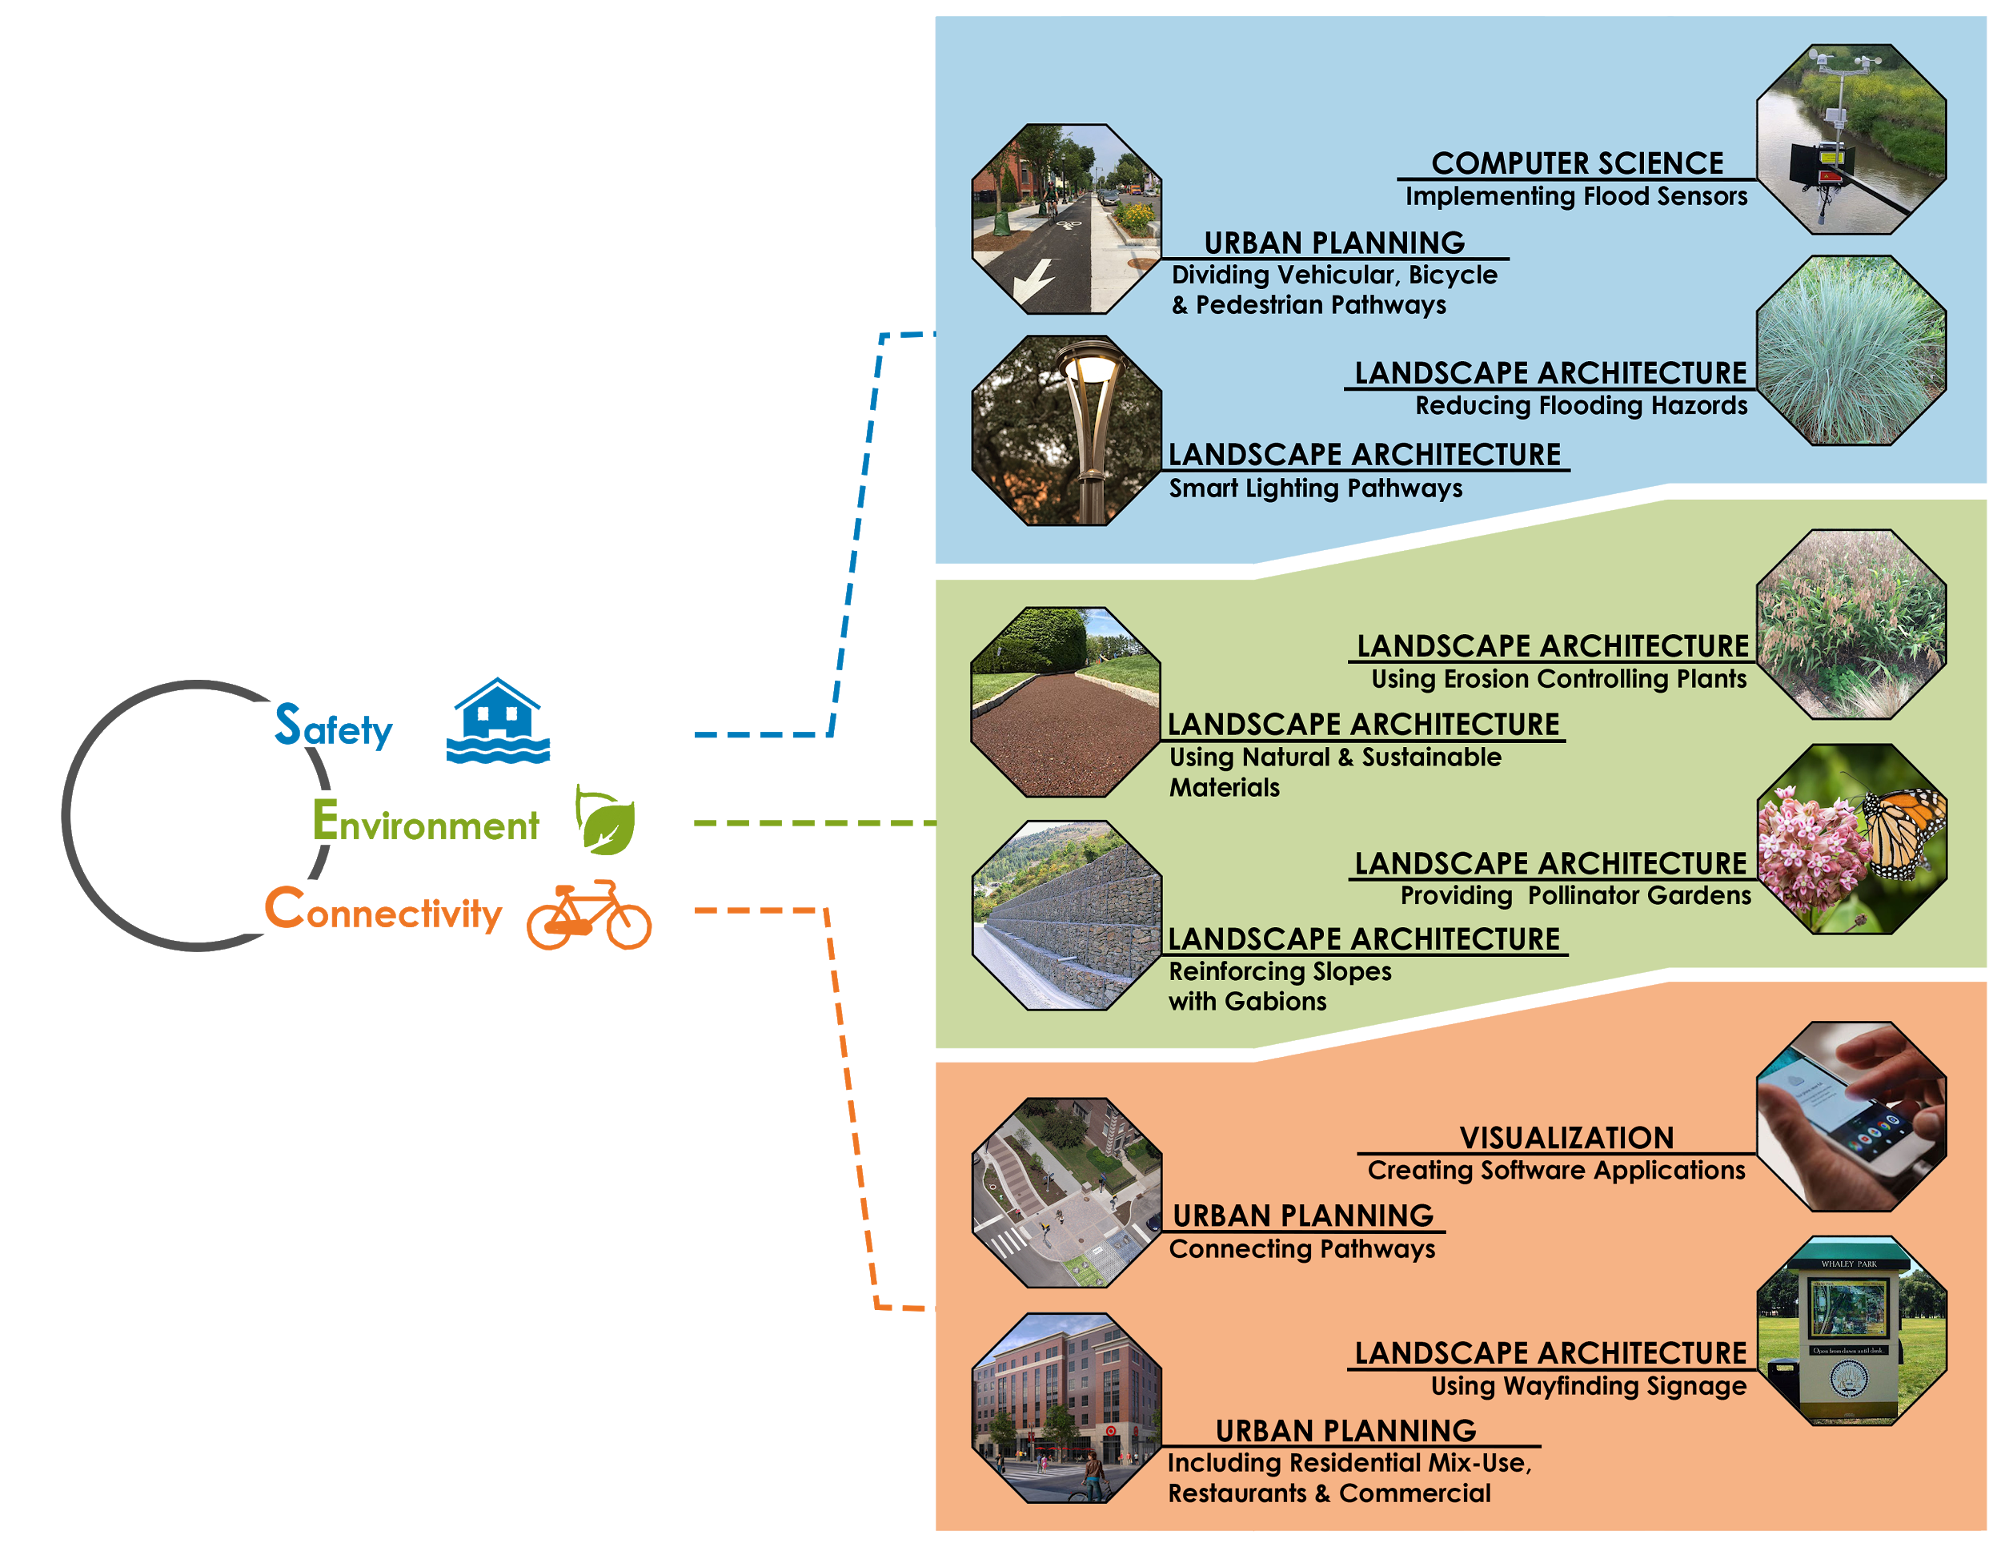
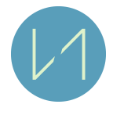
PART 01- INTRODUCTION
Mission, Goals & Objectives, & Master Plan
PART 02- TECHNOLOGICAL PROPOSAL
Machine Learning & NOVE Application
PART 03- DESIGN PROPOSAL
Site Analysis, Mix-Use, Streetscape, Planting Plan, Site Designs & Phasing Plan
TABLE OF CONTENTS

Slide 3

Mission
Our mission is to identify, record and evaluate flood-prone areas & enhance them. We plan to stabilize slopes with vegetations, mark pollinator gardens for fragile habitats, while also creating new active and educational space for residents.
Notes:
Our mission is to identify, record and evaluate flood-prone areas and enhance them. We plan to stabilize slopes with vegetations, mark pollinator gardens for fragile habitats, while also create new active and educational spaces for residents. By developing a digital application, we want to guide and help residents avoid flood zones and train traffic to enhance their daily life and facilitate communication.

Slide 4

Goals & Objectives
Smart Lighting Features
Gabion Edge Reinforcement
Flood Sensors
Flood Prediction System
Pollution Sensors
Edge Stabilizing Plants
Pollinator Plants
Natural & Sustainable Materials
City Wide Trail
Wayfinding Signage
Software Application
Mix-Use Spaces

Slide 5
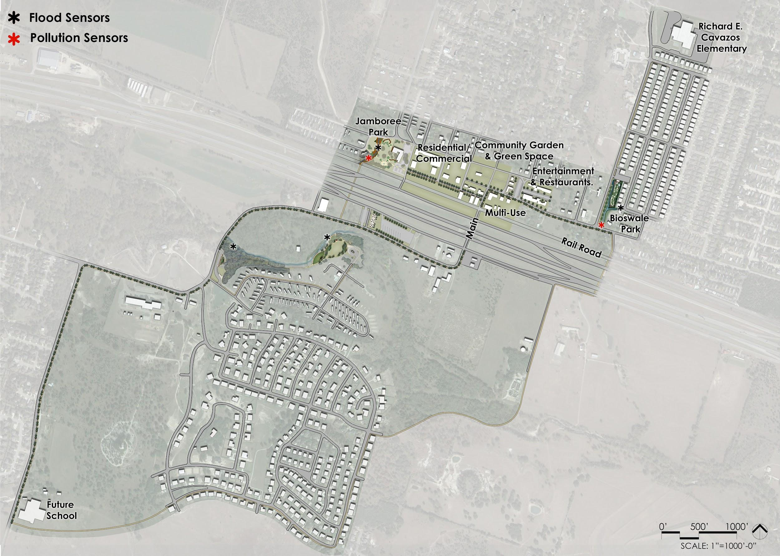
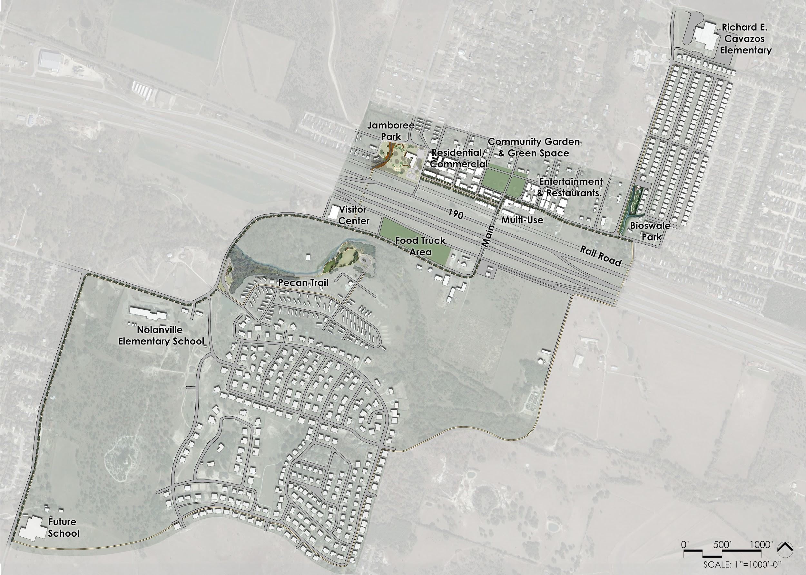
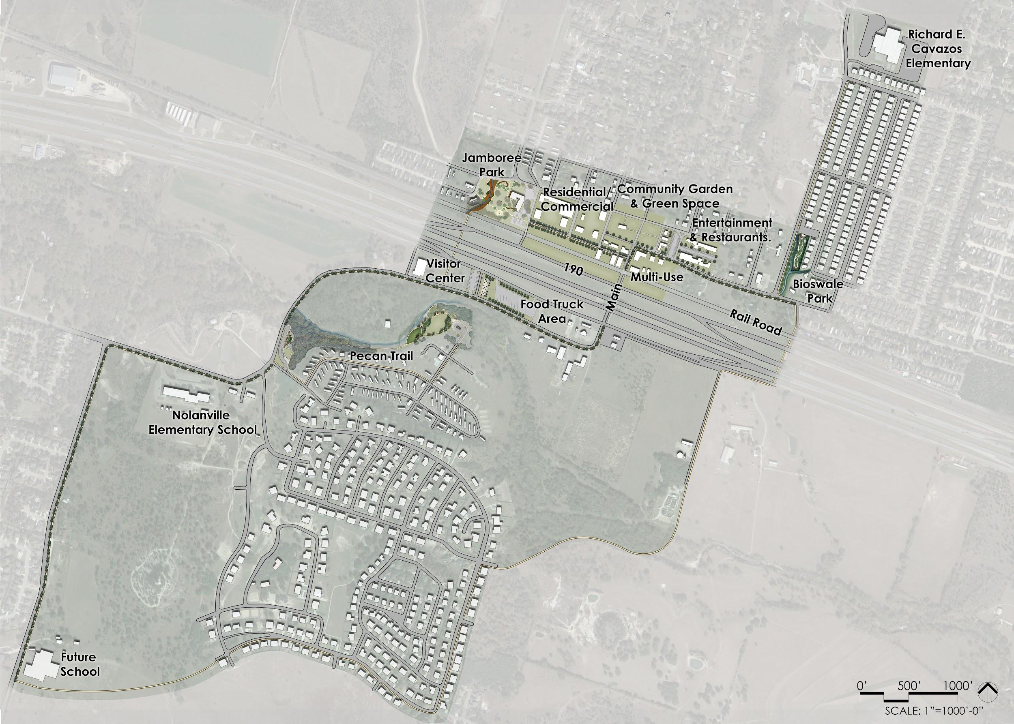
Master Plan
S - Erosion control & Flood warning system
E - Tree canopy coverage & Pollinator gardens
C - Mixed use space & City wide communication app
Notes:
The masterplan will have smart lighted walkways, walking and bike trials with tree canopy coverage. The goal is to create a trail system that connects the entire city of Nolanville.

Slide 6
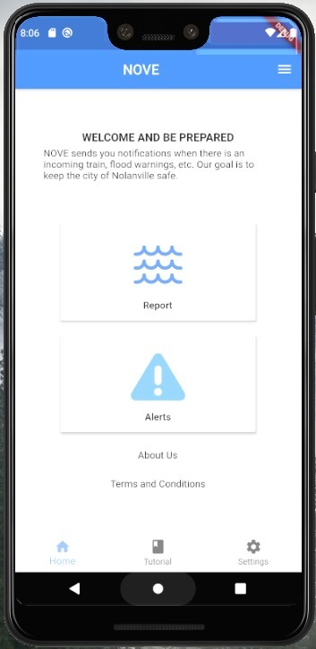
App: NOVE Layout
Incident reporting app
Alerts is for the User to notify the government
Reports is meant for the government to notify the citizen
Simplified landing page from last presentation
Notes:
The picture show the general layout of the Nolanville Incident Reporting App. Through our app, different incidents can be reported such as flooding, train blockage, fire etc. Clicking on the report button on the homepage will lead us to a map where markers can be placed at the location of the incident. The flood incident reporting can be used as data for a machine learning, which will be further explained. Currently we are using Flutter to develop this app in order to make it easier to deploy on both iOS and Android devices.

Slide 7
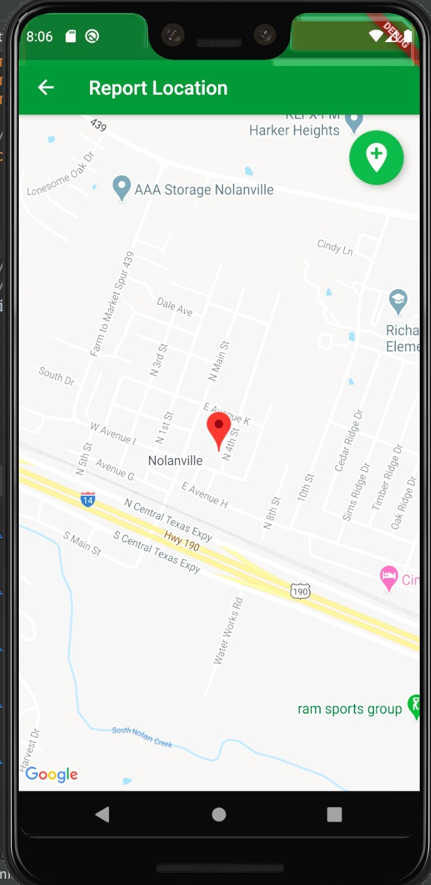
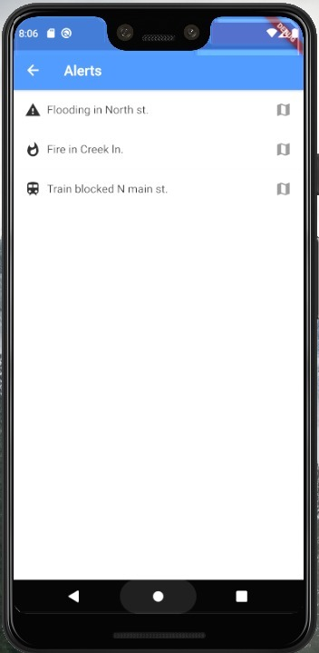
App: NOVE Layout
Report page
Residents can report the fires, flooding, and trains themselves.
For now it is unregulated, but in the future local government employees can regulate alerts.
Alert page
Residents can be notified of incoming trains, flooding, or fires.
Map-rerouting option
Notes:
The user has the ability to report incoming warning to the government in the Alert page. In the Report page, the app will show the user recent alerts. The map can also re-route the user out of potential traffic delay if there is going to be a train that will block their current path. When they do alert the app, the app will ask for the user’s location. If the incident is happening in another location, the user can drag the marker to the correct location of the incident.

Slide 8
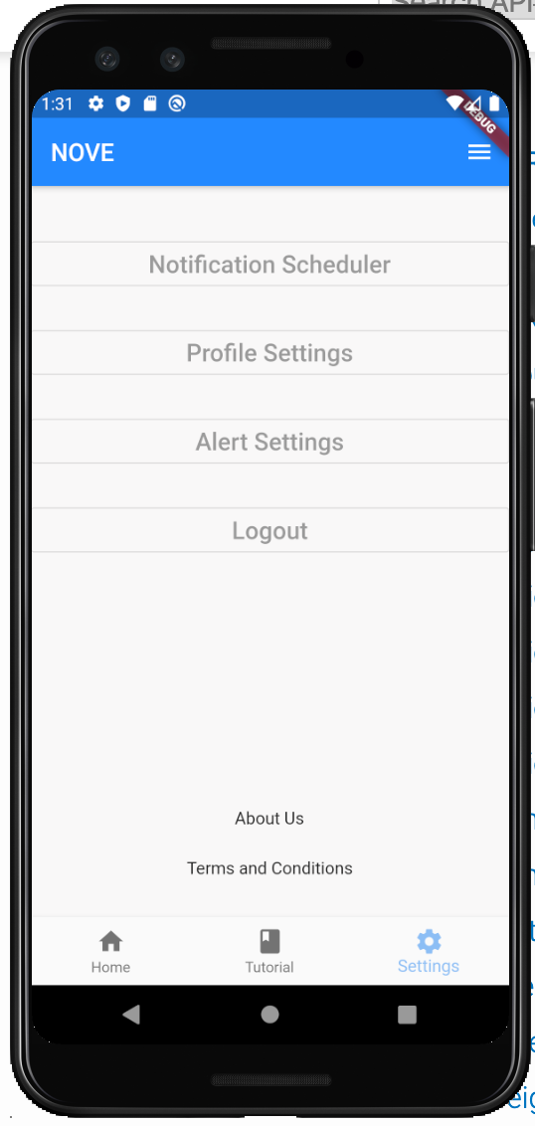
App: Configuring the settings
Information we learned that is incorporated into the app:
There are four main exits in Nolanville that are blocked by the train and the train can block residents for up to 45 minutes
Can reroute the citizens away from the blocked intersections
Citizens suggested the option to limit what time intervals they can receive messages
The specific flood zones in the map
How to reach out to residents of Nolanville
Notes:
During the team’s independent trip to Nolanville on February 15th, we interviewed the residents of Nolanville ourselves to obtain additional information that would be instrumental in developing our app and maximizing utility.
We have learned that there are four main exits that are blocked by the trains. These exits can be blocked for a few minutes because the train is just passing by, which is a minute nuisance for most, or to up to 45 minutes because the train has stopped completely to allow other trains to pass.
Our goal for this is to accurately characterize trains that will completely stop and block intersections for a significant amount of time. If this situation arises, we can notify the resident in accordance with their desired time interval to receive notifications and give them the option to reroute themselves to drive around the blocked intersections.

Slide 9
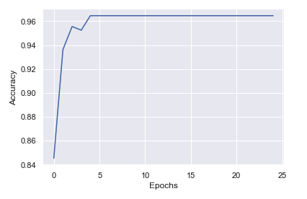
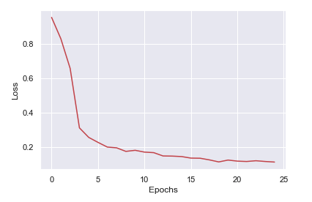
Machine Learning: Flood Classification
Had an initial model with 75% accuracy
We modified our initial neural network to be a classification model from a scale of 1 to 5
The scale represents how bad the flood will be such as being ‘ankle deep’
Model Features
(High, Avg, Low) - Temp, DewPoint, Humidity, Sea Level Pressure, Visibility, WindSpeed
Wind Gust, Precipitation Sum, Classification
Improved the model accuracy to 95.5%
Notes:
We used a simple dataset about the climate conditions in Austin, TX. Austin has a similar elevation level to Nolanville so this was helpful. We only had about 1300 data points with data such as temperature, dewpoint, humidity, sea level pressure, wind gust speed, and precipitation sum for a certain day. We ran the data through a simple neural network with a classifcation system from 1 to 5.‘dangerously deep’, ‘feet don’t touch deep’, ‘knee deep’ and ‘waist deep’. Through this neural network we were able to get a accuracy of about 95%. You can see our loss curve declining showing improvement

Slide 10
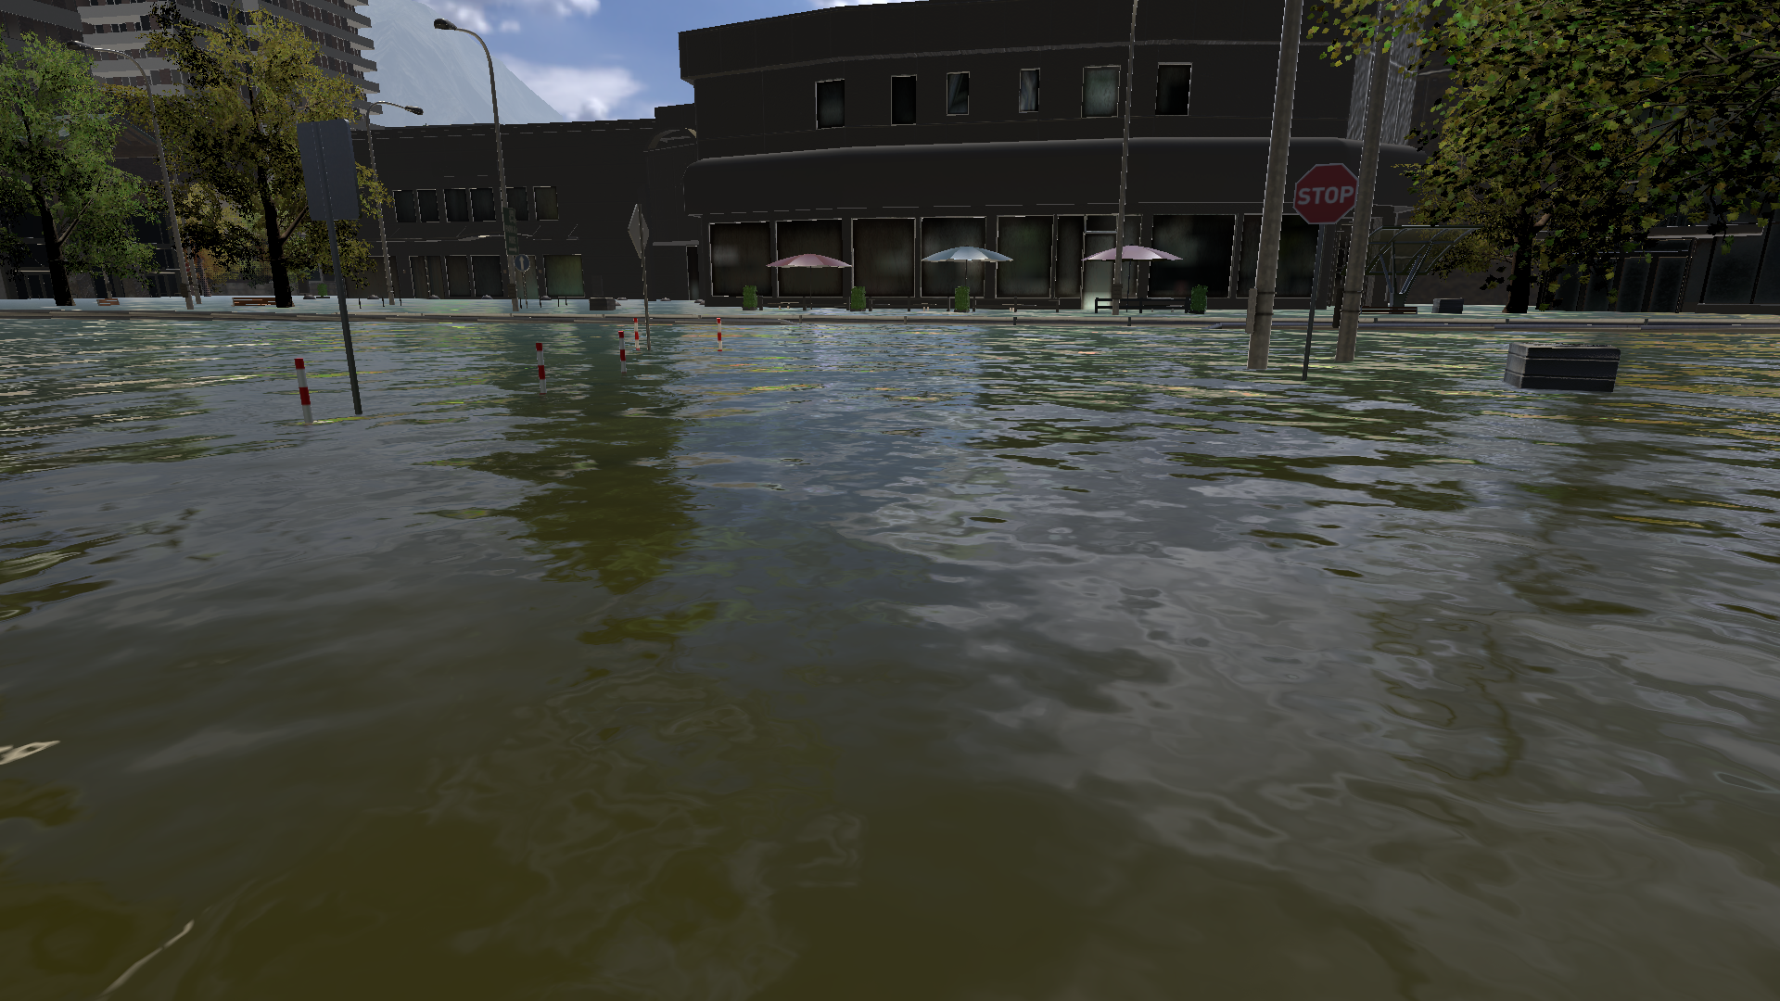
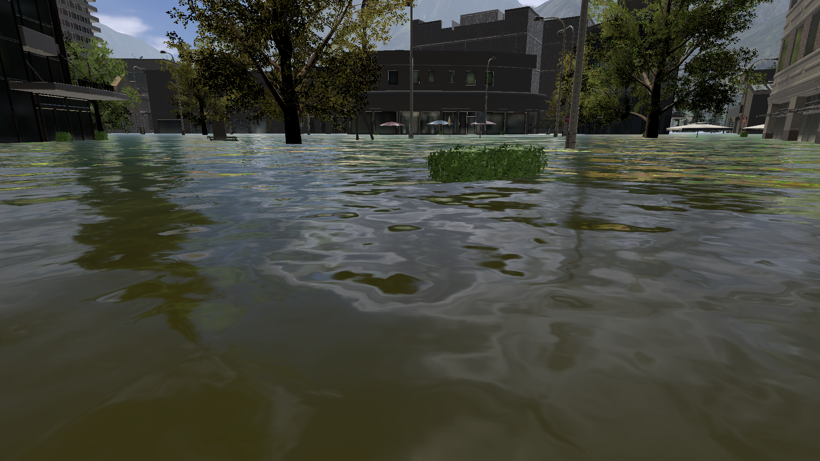
Machine Learning: Flood Level Simulation
“If we can’t go to Nolanville, let’s bring Nolanville to us”
~Aashish Ananthanarayan at 4:06 a.m. last Friday
Due to COVID-19, we were unable to visit Nolanville to collect flood data for testing.
Project Safe Waters is an open-source repository that allows people to use their data and model to predict flood levels and improve accuracies and utilize it on custom data. It was part of the 2019 IBM Challenge.
Instead of collecting flooding images, a Unity model of a city was built and flood levels were annotated through the IBM Watson ML interface.
Notes:
We used a simple dataset about the climate conditions in Austin, TX. Austin has a similar elevation level to Nolanville so this was helpful. We only had about 1300 data points with data such as temperature, dewpoint, humidity, sea level pressure, wind gust speed, and precipitation sum for a certain day. We outlined all the possible graph combinations with each feature and saw a decent amount of correlation between some features such as dewpoint and temperature. We ran the data through a simple neural network with precipitation being the outcome we were looking for and got a 75% accuracy on our model. We believe if we have more data, we can build a better model.

Slide 11
Machine Learning: Flood Level Simulation
“If we can’t go to Nolanville, let’s bring Nolanville to us”
~Aashish Ananthanarayan at 4:06 a.m. last Friday
After annotation, pretrained weights were obtained and the model was then tested for 9900 images.
Flooding was classified as ‘dangerously deep’, ‘feet don’t touch deep’, ‘knee deep’ and ‘waist deep’.
The next phase of this process is to build a few streets/neighborhoods from Nolanville using Unity and testing those images with the model
Notes:
We used a simple dataset about the climate conditions in Austin, TX. Austin has a similar elevation level to Nolanville so this was helpful. We only had about 1300 data points with data such as temperature, dewpoint, humidity, sea level pressure, wind gust speed, and precipitation sum for a certain day. We outlined all the possible graph combinations with each feature and saw a decent amount of correlation between some features such as dewpoint and temperature. We ran the data through a simple neural network with precipitation being the outcome we were looking for and got a 75% accuracy on our model. We believe if we have more data, we can build a better model.

Slide 12
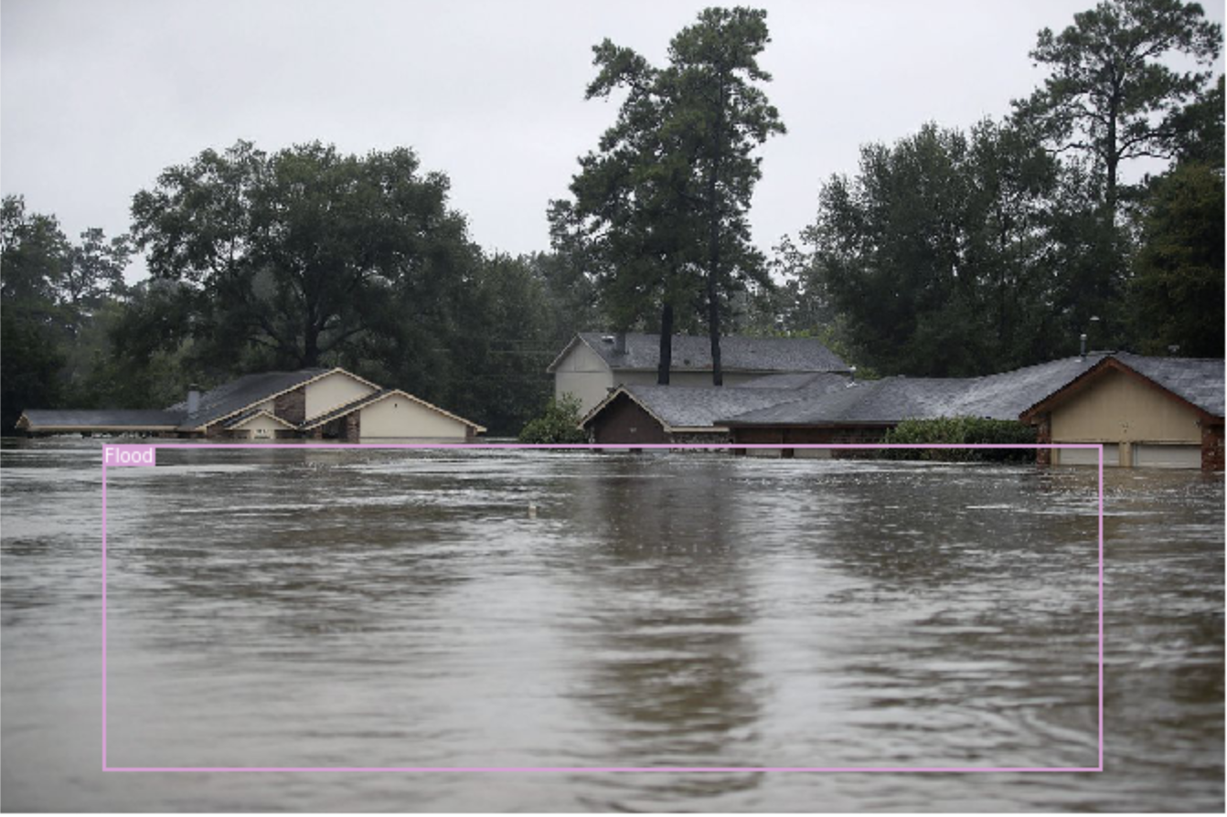
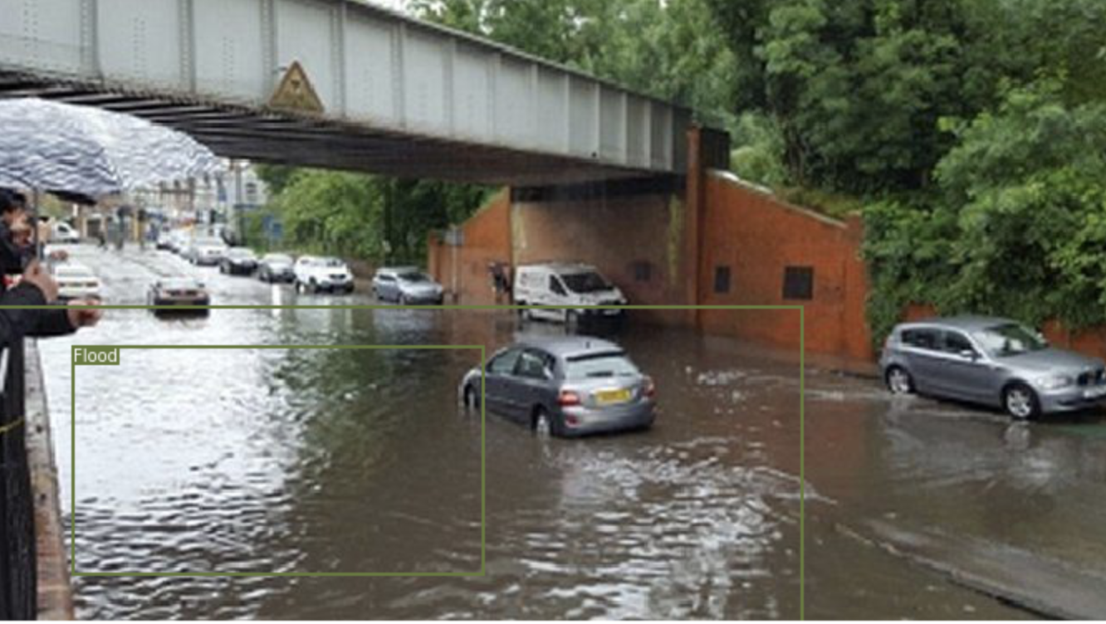
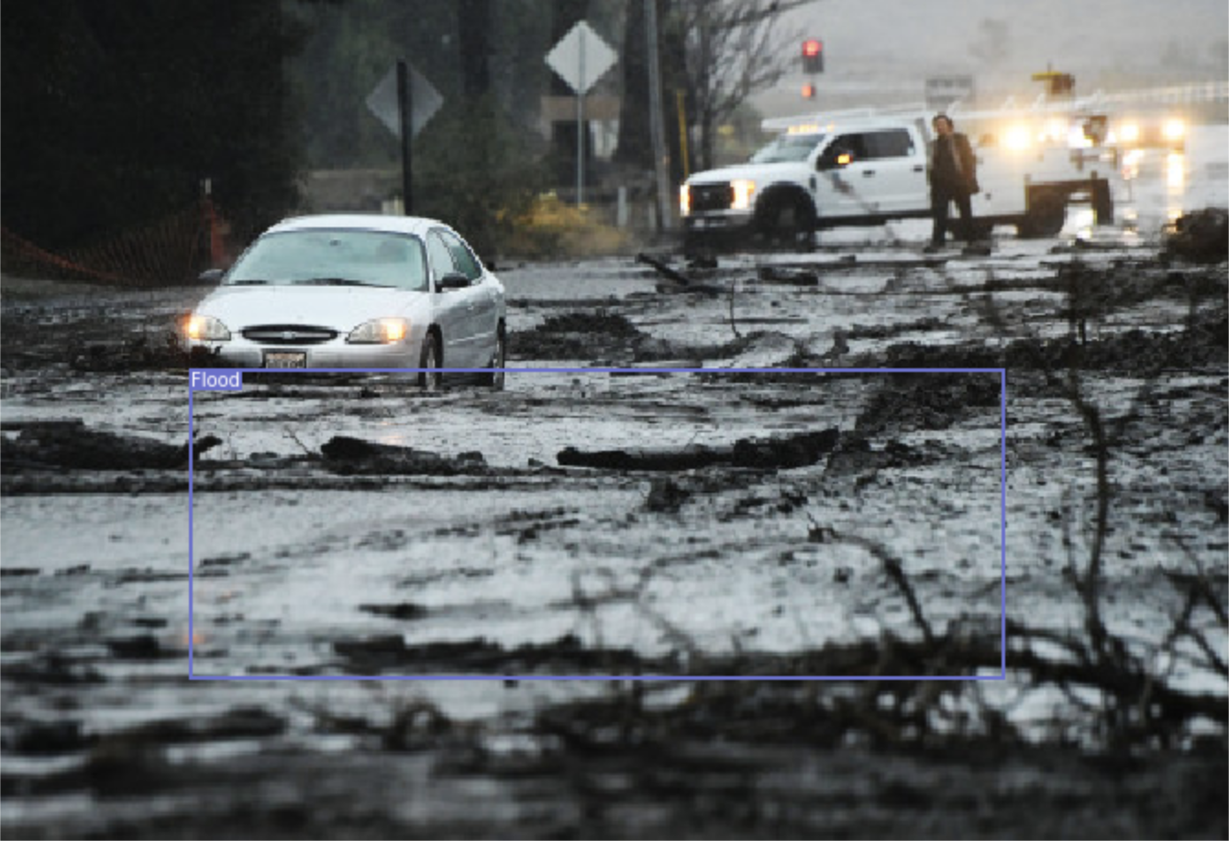
Machine Learning: Real-time flood detection
This is a common research problem that can be made use of to detect floods in real time and alert citizens if the flood level is too high.
For this, we used the YOLO neural network to experiment and see if we could analyze the presence of a flood.
This could then be used on Nolanville pictures to detect the presence of floods through surveillance cameras and could even be applied to flood level detection in the future
Notes:
We used a simple dataset about the climate conditions in Austin, TX. Austin has a similar elevation level to Nolanville so this was helpful. We only had about 1300 data points with data such as temperature, dewpoint, humidity, sea level pressure, wind gust speed, and precipitation sum for a certain day. We outlined all the possible graph combinations with each feature and saw a decent amount of correlation between some features such as dewpoint and temperature. We ran the data through a simple neural network with precipitation being the outcome we were looking for and got a 75% accuracy on our model. We believe if we have more data, we can build a better model.

Slide 13
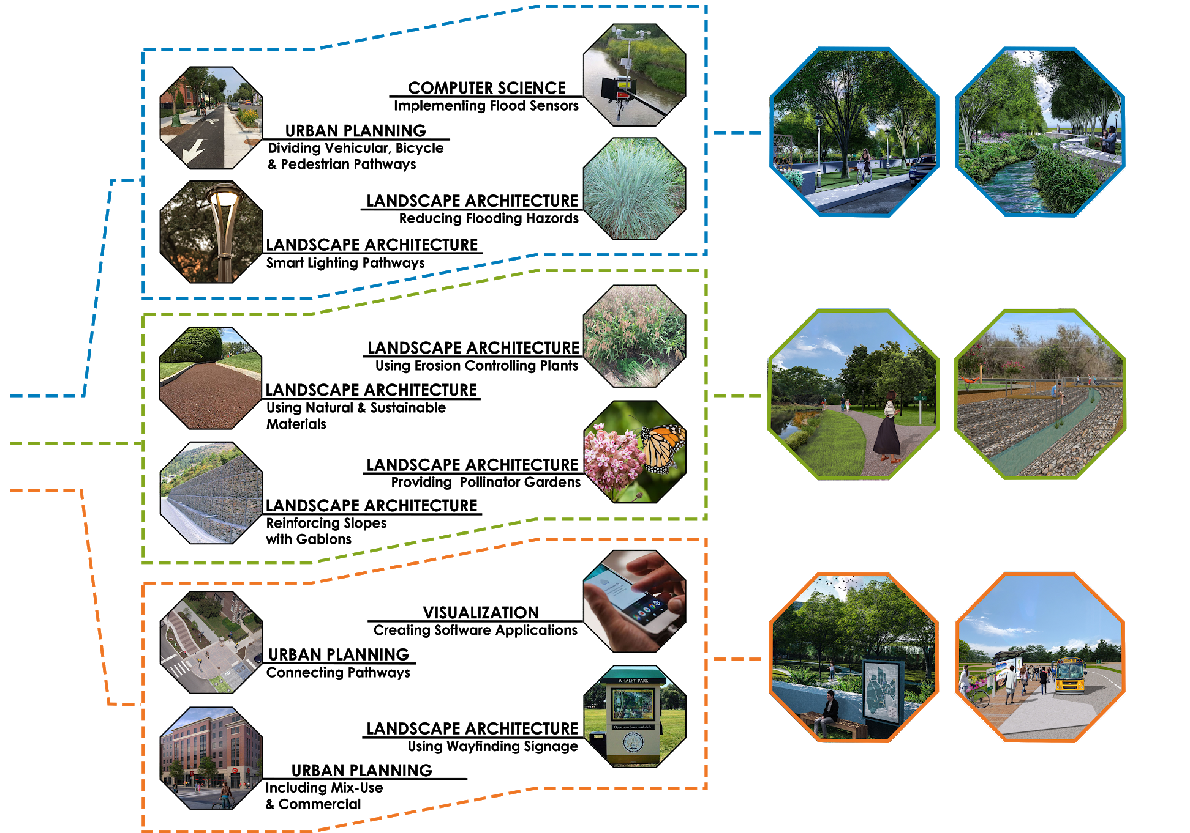
Summary

Slide 14
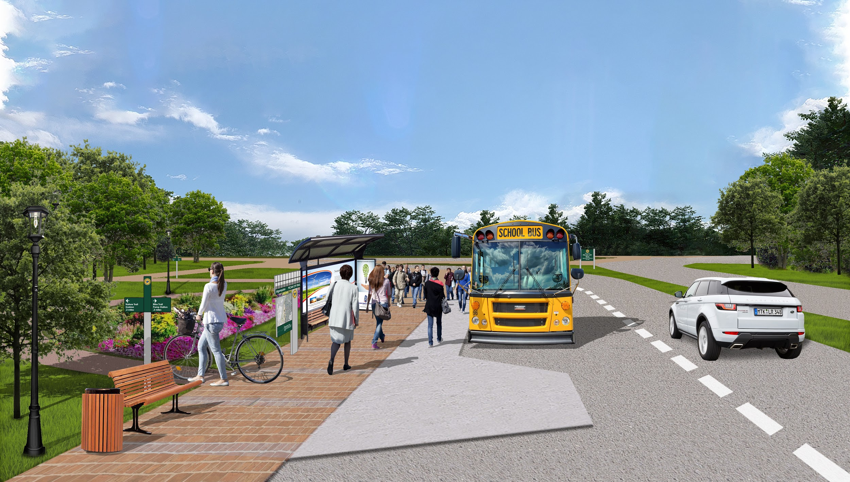
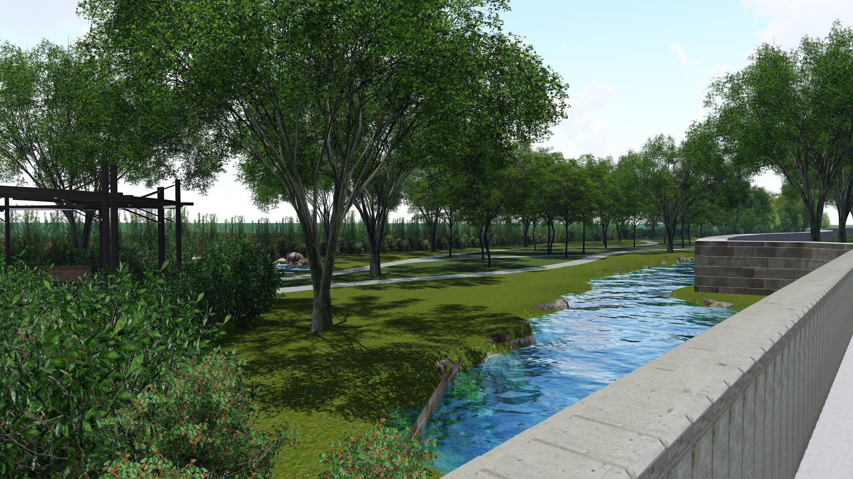
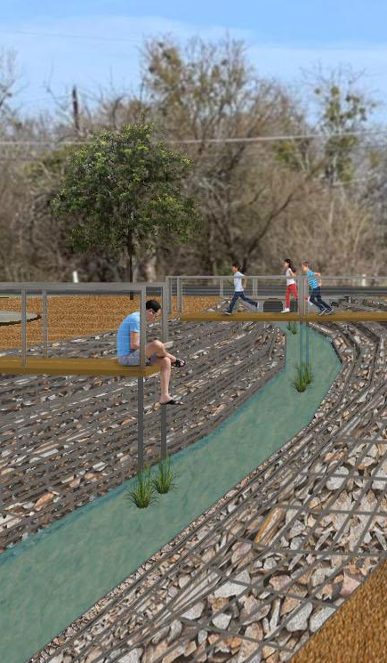
THANK YOU!

